Slide 1
El - Farol Bar Problem
A Case Study in Minority Games
Anant Shah, Abhijeet Panpaliya, Mohit Shrivastava
(EE16B105,EE16B069,EE16B157)

Slide 2
Minority Games
A game in which the players in the minority win.
Model real world scenarios in which players are bounded in rationality.
Actual players do not have perfect foresight and hindsight.
Most of their actions are based on trial-and-error inductive thinking, rather than deductive rationale assuming that there are underlying first principles.
What type of thinking is relevant is still under debate.

Slide 3
Why does this appeal to statistical mechanical researchers?
Problem characteristics include interaction of many individuals.
These new models consider the dynamical evolution towards the steady state through evolution, adaptation and learning of the individuals.
Leads to different questions like that of existence of steady state and stability.
Can be thought of as interactions of different degrees of freedom for which many powerful tools and intuitions have been developed.

Slide 4
EL Farol Problem
The El - Farol Bar problem illustrates inductive reasoning and how it might be modelled.
This problem was first introduced by W. Brian Arthur in 1994.
The problem was inspired by the bar EL Farol in Santa Fe, which offers Irish music on Thursday nights and other enjoyments to go with it.
In a village with N people, each of them independently decide to go to bar or no. If the bar is overcrowded then they people in the bar would have preferred to stay at home.
All of the villagers have to take the decision at the same time, without communicating with others.
The information that the villagers have is the attendance of the past few weeks.

Slide 5
Kolkata Paise Restaurant Problem
This is another variation of the EL Farol bar problem, where the number of players and the number of choices are large. The number of choices correspond to the which restaurants the players can visit.
This problem was based on daily labourers of Kolkata.
As was in the case of El Farol Problem, each player has information regarding the history of the choices made by different players.

Slide 6
Characteristics of the Game
This is an iterative game, where the best strategy of a player is being updated over time.
Each player in this game has a different set of strategies, while in the games we studied in class each player had similar set of strategies.
Since the player does not have information about the strategy of other players he cannot have a well defined model.
This is a symmetric game.

Slide 7
Formal Description
The number of players in this game are N.
The information that each player has is the attendance of the past M weeks, where M is the memory size of all players.
Each player has a different set of strategies from which he picks his current best performing strategy.
The utility of the player is binary : +1 if the player had a good time, and -1 in the other scenario.
Given a certain threshold, a player enjoys if he is in the minority.
This is a non-cooperative game where the players cannot communicate with each other.

Slide 8
Simulation

Slide 9
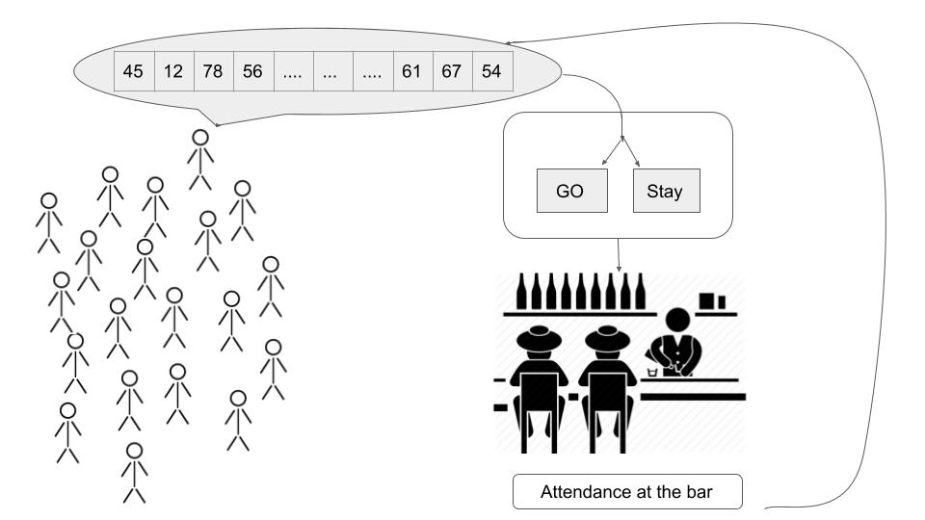

Slide 10
Algorithm
Initialize Attendance : Randomly generate attendance the past few weeks, which is common knowledge of all players.
Initialize Strategies : Each player has a Strategy set with same cardinality. For each player we have randomly generate strategies, which predict the future attendances based on linear combination of previous week.
Decision Making : Based on the current best strategy, player decides whether to go to the bar or not. Based on the decision of all players, we get the turn-out of this week.
Update Best Strategy : From the attendance obtained, the players now update their memory and select their best strategy for the next week.
This process continues for multiple weeks.

Slide 11
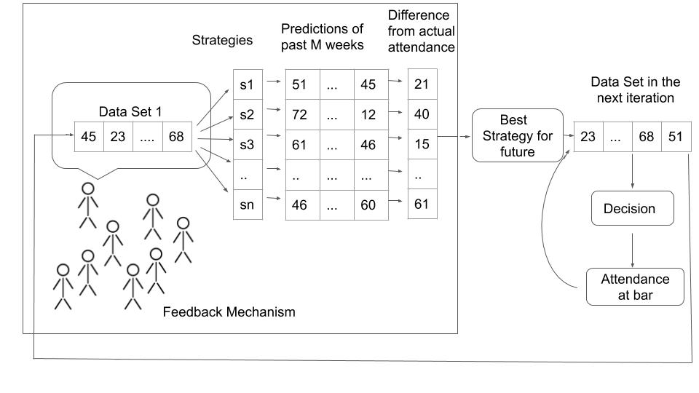

Slide 12
Implementation

Slide 13
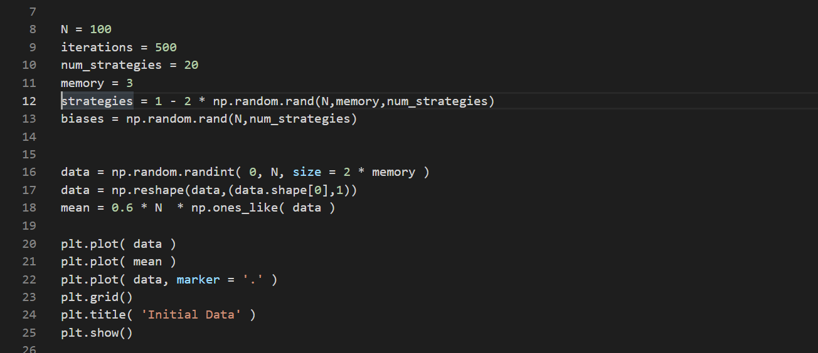

Slide 14
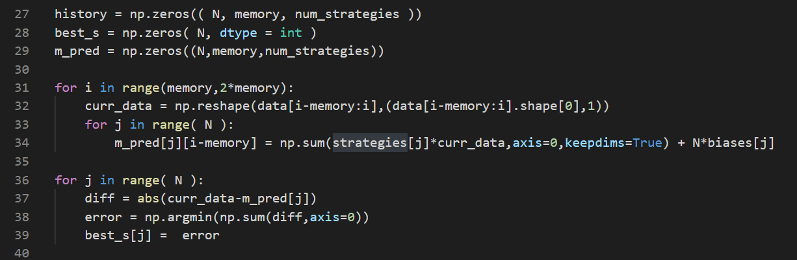

Slide 15
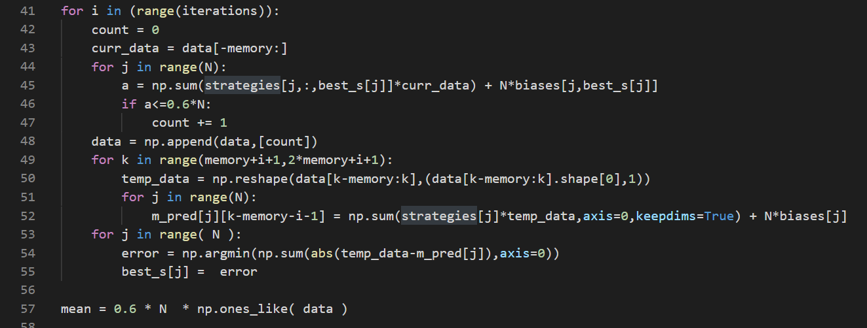

Slide 16
Results

Slide 17
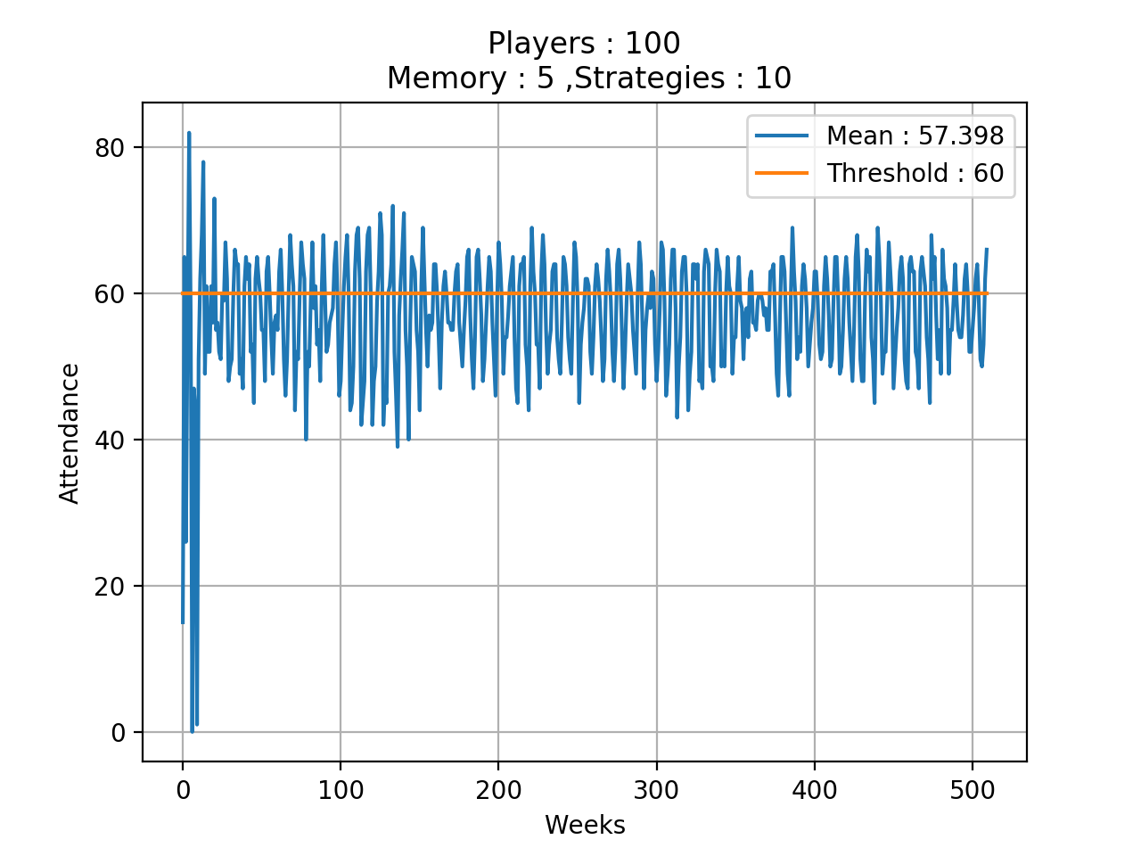
Attendance at Bar over time

Slide 18
Variations with Memory

Slide 19
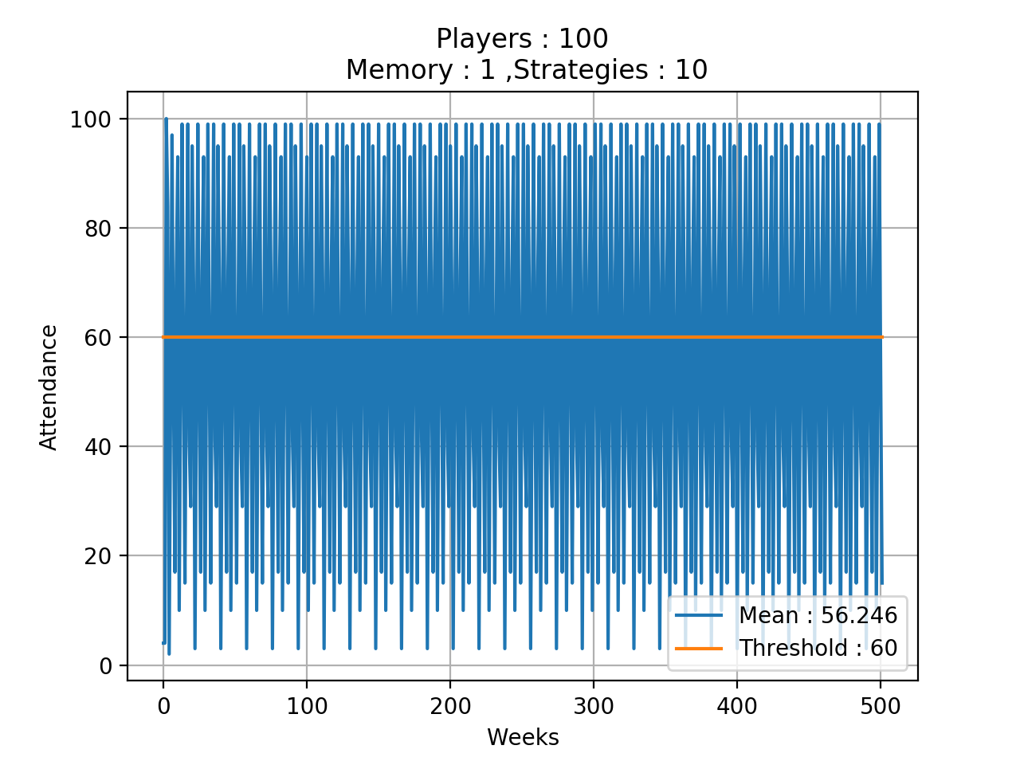
Variations with Memory

Slide 20
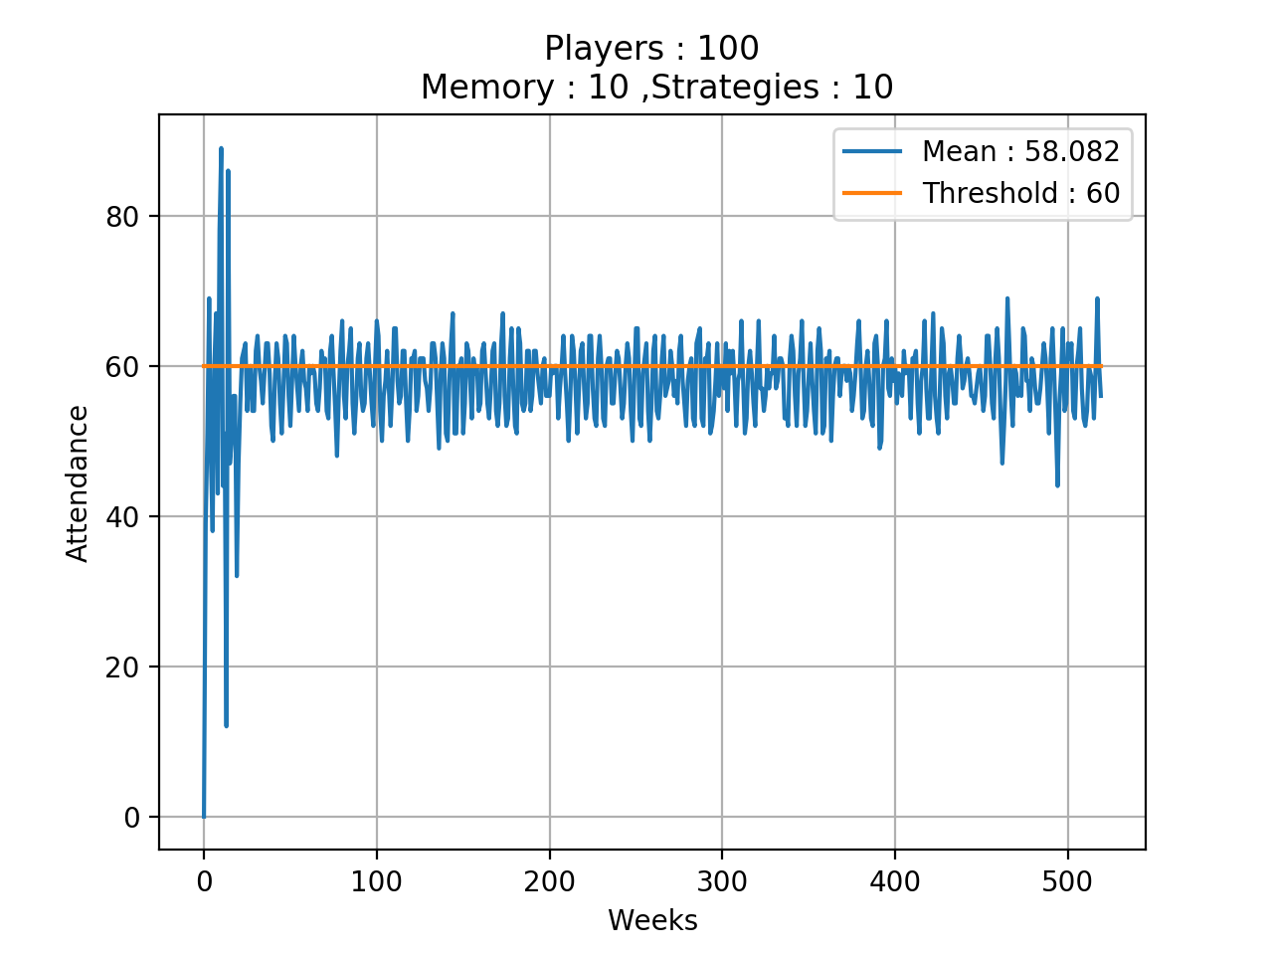
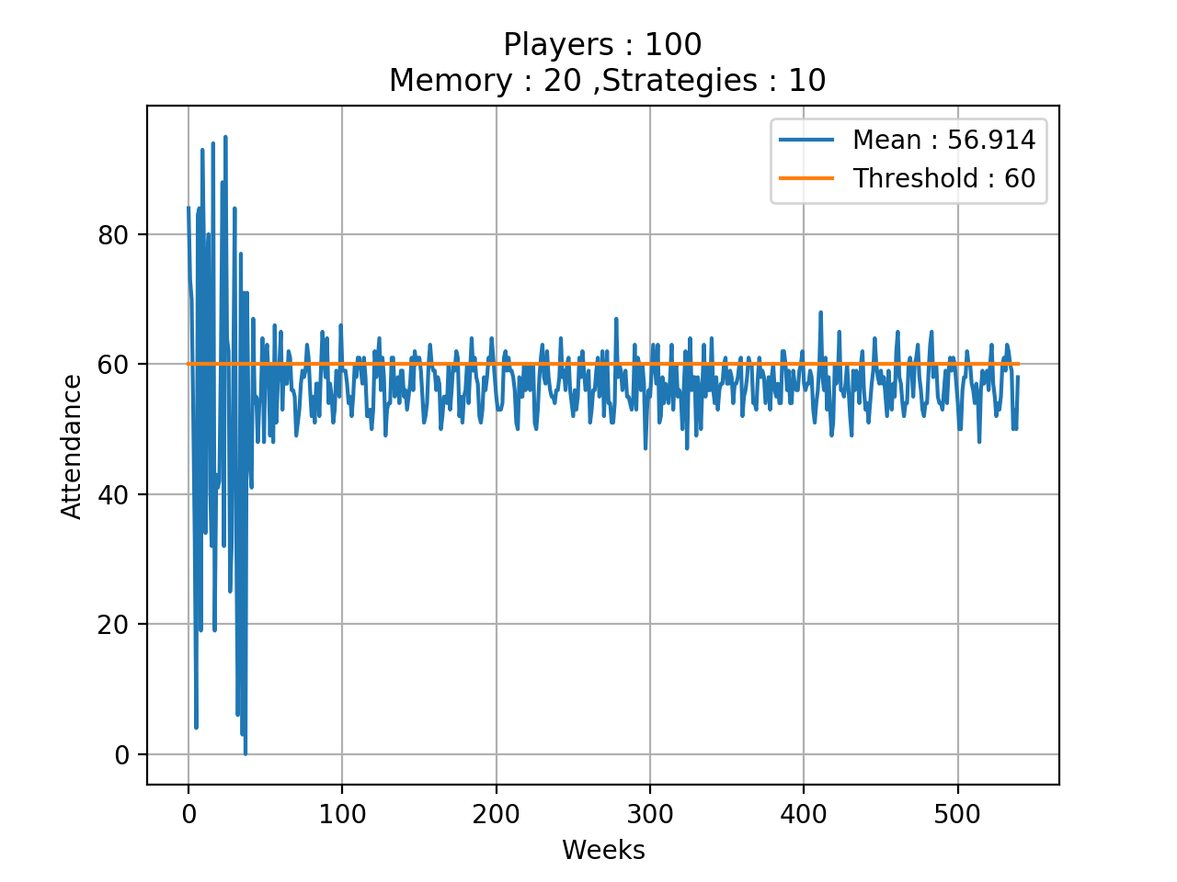
Variations with Memory

Slide 21
Variations with Number of Strategies

Slide 22
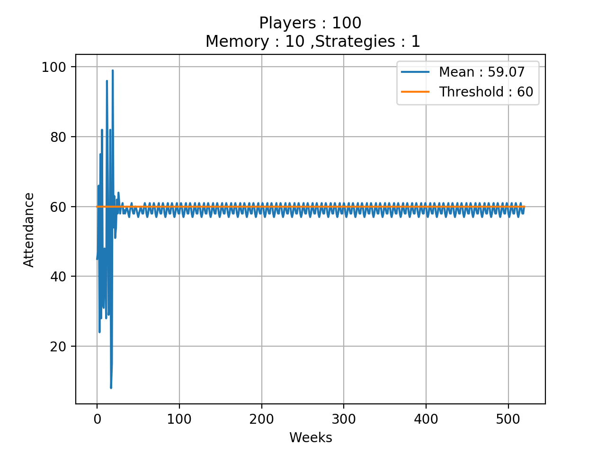
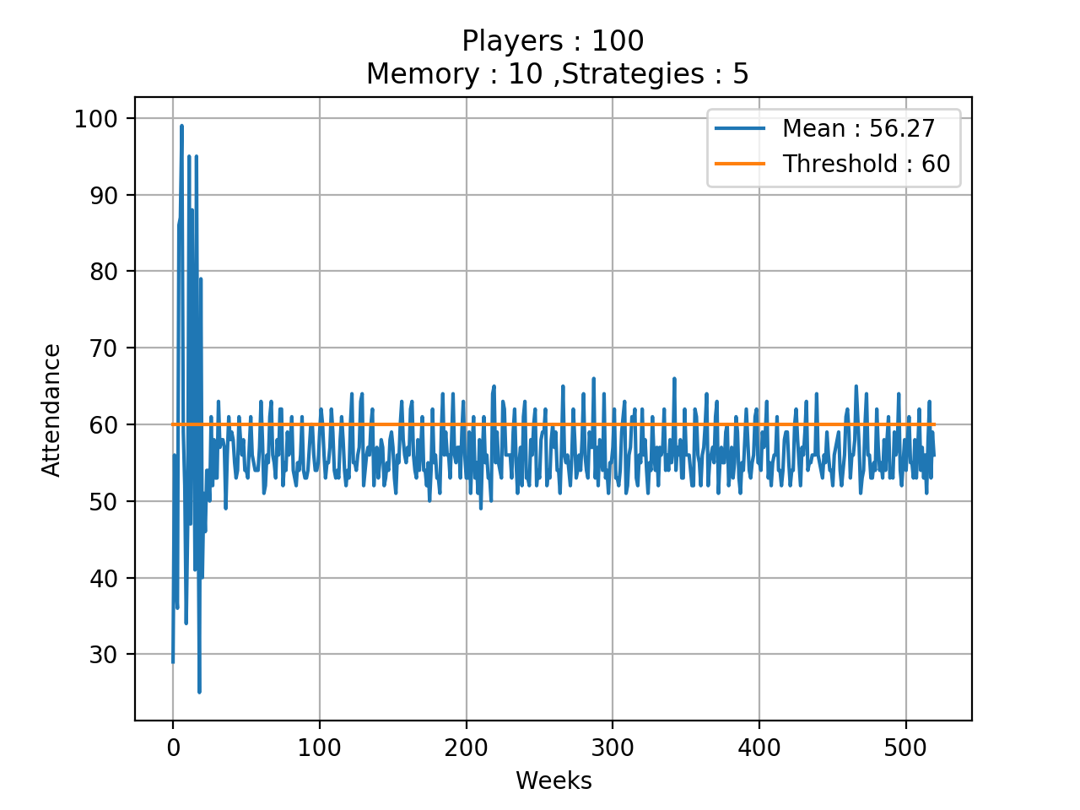
Variations with Number of Strategies

Slide 23
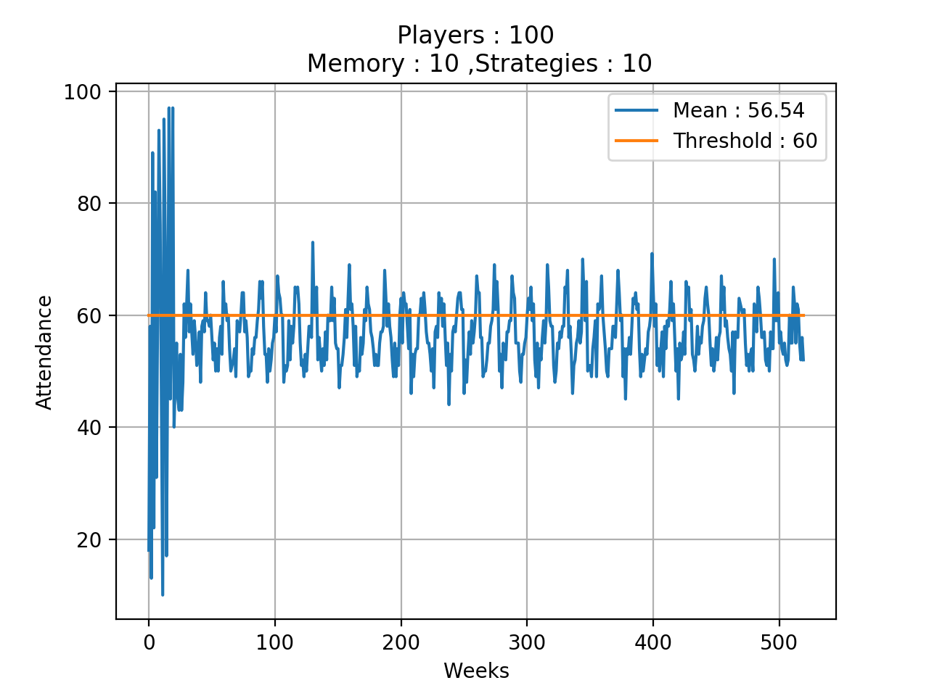
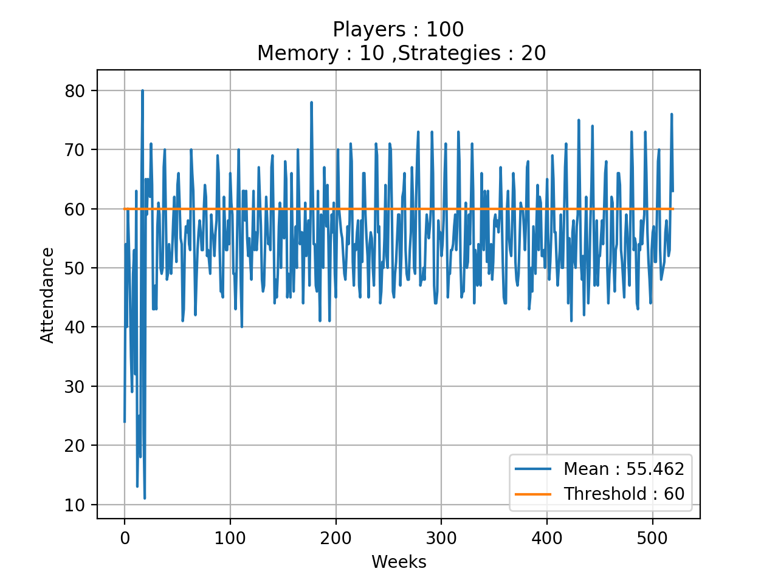
Variations with Number of Strategies

Slide 24
Inferences
When we keep the number of players at 100 and number of strategies for each player at 10, we observe that the oscillations about the threshold decrease as the memory of each player increases. Also, the mean gets closer to the threshold.
With memory size fixed, as we increase the cardinality of strategy sets, we observe that the variation of the attendance data around the threshold increases.

Slide 25
References
Emergence of cooperation and organization in an evolutionary game -
https://www.sciencedirect.com/science/article/pii/S0378437197004196
The Minority Game: an introductory guide - https://arxiv.org/pdf/cond-mat/0402651.pdf
Inductive Reasoning and Bounded Rationality - http://tuvalu.santafe.edu/~wbarthur/Papers/El_Farol.pdf

Slide 26
Thank You!

